Slide 1
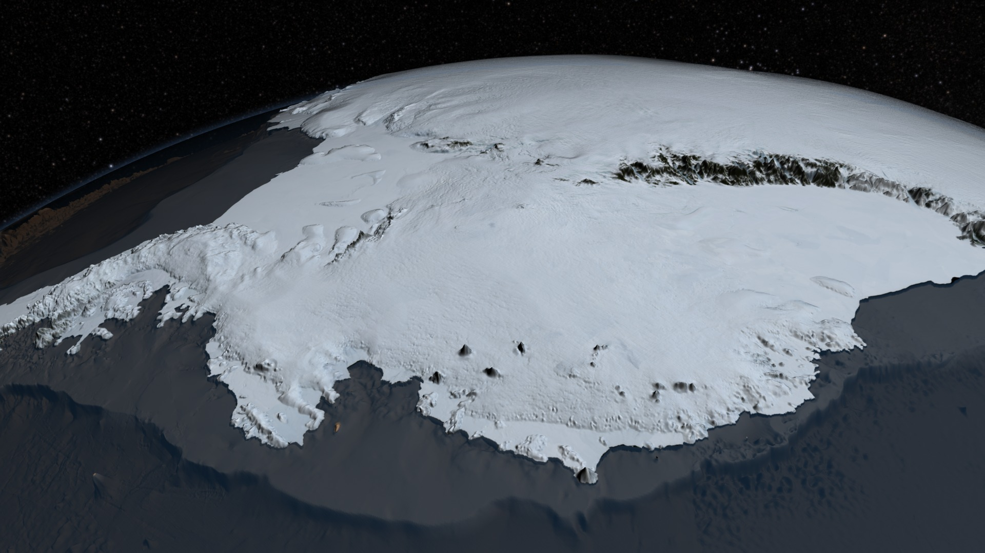

Polar Ice melt and Sea Level Rise
Antarctic Ice Sheet (Visualization from NASA's mission Operation IceBridge dataset BEDMAP2)
By Lea Fortmann and Penny Rowe with funding from the National Science Foundation.
Notes:
Image from https://en.wikipedia.org/wiki/Antarctic_ice_sheet#/media/File:AA_bedrock_surface.4960.tif

Slide 2
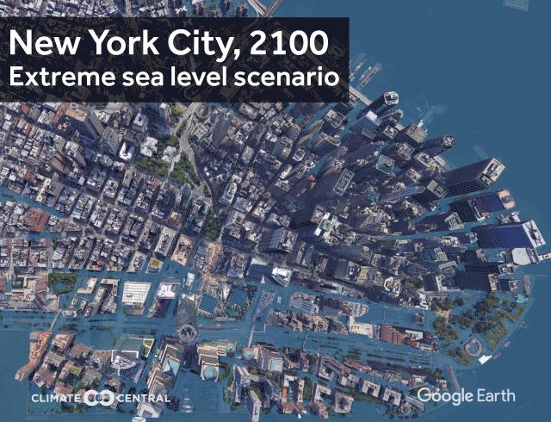
Learning Objectives and Module Overview
In this module you will explore:
Why is sea level rising and how are polar regions contributing?
What is storm surge and how will it affect us?
How should we prepare?
From Climate Central
(https://www.climatecentral.org/outreach/alert-archive/2017/2017SeaLevelCM-TVM.html)

Slide 3
Learning Objectives and Module Overview
In this module you will explore:
Why is sea level rising and how are polar regions contributing?
What is storm surge and how will it affect us?
How should we prepare?
From Climate Central
(https://www.climatecentral.org/outreach/alert-archive/2017/2017SeaLevelCM-TVM.html)

Slide 4
Part 2: Graphing Marginal Damage Curves
The marginal damage tables are a helpful way to organize the data and do some basic calculations, but when presenting the data, graphs are a better way to convey a lot of information in one figure. In this section you will make graphs of the expected marginal damages you just calculated in Excel.
Click on the “Part 2: MD graphs” tab at the bottom of the Excel spreadsheet. Tables 4 and 5 show the expected marginal damages from flooding for each SLR scenario for the year 2050 (Table 4) and 2100 (Table 5). Note: The tables have automatically populated with the expected MD values you calculated on the previous spreadsheet.
Excel Tip: If you click on a cell, you can see the reference cell it is drawing the data from in the formula bar (fx) at the top, where ‘MD Table’ is the sheet name you were previously working in and E26 is the cell on that sheet the data is copied from into the current cell.
Now you will create a graph with the four SLR scenarios to show the marginal damages expected at each foot of flooding. A graph of Table 4 for the year 2050 has already been made for you, in the next slide you will learn how to create the same graph for Table 5 for the year 2100.

Slide 5
Part 2: Graphing Marginal Damage Curves
To make a graph in Excel:
1. Use the cursor and drag to highlight the contents of the Table as pictured.
2. Go to the Insert tab at the top then click on the drop down options for scatter charts and select the option with smooth lines and markers.
Note: These instructions and images are for a Mac using Excel version 16.25 and may differ for a PC or other versions of Excel, but should be similar.
Excel Tip: You can click on the graph and drag it to move it around your spreadsheet. Note: The x-axis will be based on the far left-hand column units (feet of flooding) and the y-axis will be in millions of dollars. The legend is based on the column headings.

Slide 6
Part 2: Formatting Graphs in Excel
After you make your graph, you will want to add a main title to the graph and labels for the horizontal and vertical axes. If someone was to look at your graph out of context, they should be able to understand exactly what data is being displayed.
Formatting Graphs in Excel
1. To add a title, click anywhere on the graph and a Chart Design tab should appear at the top.
2. Click on on the Chart Design tab and from there you should see a drop down for adding chart elements.
3. Add a Chart Title to your graph and vertical and horizontal Axis Titles.
Pause for Analysis: What do you think are some of the underlying factors driving the shape of the marginal damage curves in the graphs? Hint: Think about the assumptions you have made when calculating the marginal damages. Discuss with a partner or in a small group.

Slide 7
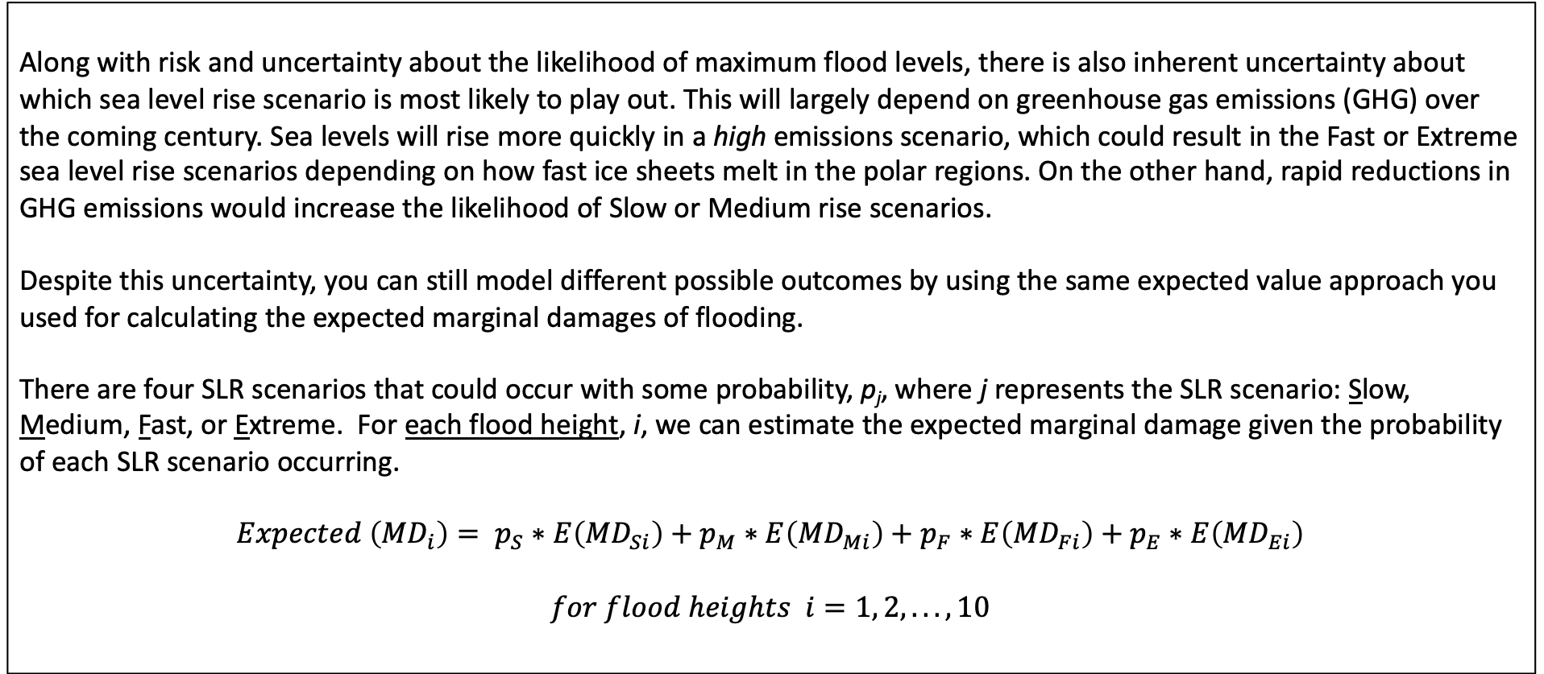
Part 3: Making Decisions Under Uncertainty
Along with risk and uncertainty about the likelihood of maximum flood levels, there is also inherent uncertainty about which sea level rise scenario is most likely to play out. This will largely depend on greenhouse gas emissions (GHG) over the coming century. Sea levels will rise more quickly in a high emissions scenario, which could result in the Fast or Extreme sea level rise scenarios depending on how fast ice sheets melt in the polar regions. On the other hand, rapid reductions in GHG emissions would increase the likelihood of Slow or Medium rise scenarios.
Despite this uncertainty, you can still model different possible outcomes by using the same expected value approach you used for calculating the expected marginal damages of flooding.
There are four SLR scenarios that could occur with some probability, p_{j}, where j represents the SLR scenario: Slow, Medium, Fast, or Extreme. For each flood height, i, we can estimate the expected marginal damage given the probability of each SLR scenario occurring.
$$Expected \left({MD}_{i}\right)= p_{S}∗E\left({MD}_{Si}\right)+p_{M}∗E\left({MD}_{Mi}\right)+p_{F}∗E\left({MD}_{Fi}\right)+p_{E}∗E\left({MD}_{Ei}\right)$$
$$for flood heights i=1, 2,... ,10$$

Slide 8
Part 3: Making Decisions Under Uncertainty
In this analysis you will refer to 3 different emissions scenarios modeled after the Intergovernmental Panel on Climate Change (IPCC) report on Representative Concentration Pathways (RCPs):
RCP 2.6* is the best case scenario which would result in the lowest sea level rise and associated warming of 0.5 to 2.8 °F by the year 2100.
RCP 4.5 is a moderate scenario in which GHG emissions stabilize by 2100, which would result in approximately 2 to 4.6°F of warming by 2100.
RCP 8.5 is the worst case scenario, which would result in the highest sea level rise and potentially the extreme scenario playing out with associated warming of 4.5 to 8.6°F by 2100.
For more information on the RCPs, you can refer to the Summary for Policy Makers by the IPCC (2013).
Pause for Analysis: Consider the best case and worst case scenarios described above. In a small group or with a partner discuss what factors (economic, social, political, technological, etc.) would increase the probability of the best case scenario playing out? What factors would increase the probability of the worst case scenario playing out?
*The number reference for the RCP scenarios refers to the radiative forcing associated with that scenario, or the “cumulative measure of human emissions of GHGs from all sources expressed in Watts per square meter” (Scenario Process for AR5 (2019) Data Distribution Centre. Retrieved from: https://sedac.ciesin.columbia.edu/ddc/ar5_scenario_process/RCPs.html).
Notes:
Summary for Policy Makers Report (IPCC 2013) website: https://www.ipcc.ch/site/assets/uploads/2018/02/WG1AR5_SPM_FINAL.pdf

Slide 9
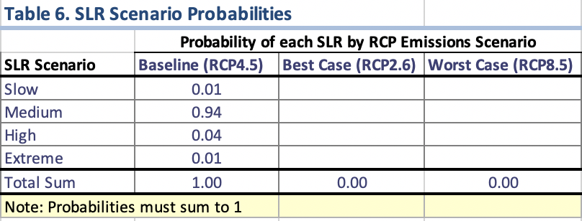
Part 3: Making Decisions Under Uncertainty
Now you will consider probabilities of sea level rise for 3 different GHG emissions scenarios: Baseline, Best Case and Worst Case. In Part 3 of the Excel spreadsheet on the “Cost-Benefit Graph” tab, the first column in Table 6 shows the probabilities of each SLR scenario occurring under a Baseline scenario (RCP4.5). The numbers are roughly based on a 2017 NOAA report. Using these as a starting point, you will consider probabilities for SLR under the Best and Worst Case scenarios.
1. Fill in probabilities for the Best and Worst case scenarios in Table 6 based on what you think the likelihood is of each SLR scenario occurring given your discussion on factors driving the best and worst case emissions scenarios from the previous slide.
Notice that as you fill in the probabilities, Table 7 populates with the expected marginal damages for each foot of flooding for the respective emissions scenarios, along with the graph of the marginal damages associated with each emissions scenarios in Figure 3.
2. To get a sense of how the probabilities affect the marginal damage curves in Figure 3, play around with entering in different probabilities for the Best and Worst Case scenarios in Table 6.
Pause for Analysis: What is a claim you can make about the marginal damages from sea level rise based on the probabilities you have entered and your analysis of the graph in Figure 3?
Notes:
NOAA 2017: Sweet, W. V., Kopp, R. E., Weaver, C. P., Obeysekara, J., Horton, R. M., Thieler, E. R., and Zervas, C. (2017). Global and Regional Sea Level Rise Scenarios for the United States. NOAA Technical Report NOS CO-OPS 083. Retrieved from: https://tidesandcurrents.noaa.gov/publications/techrpt83_Global_and_Regional_SLR_Scenarios_for_the_US_final.pdf

Slide 10
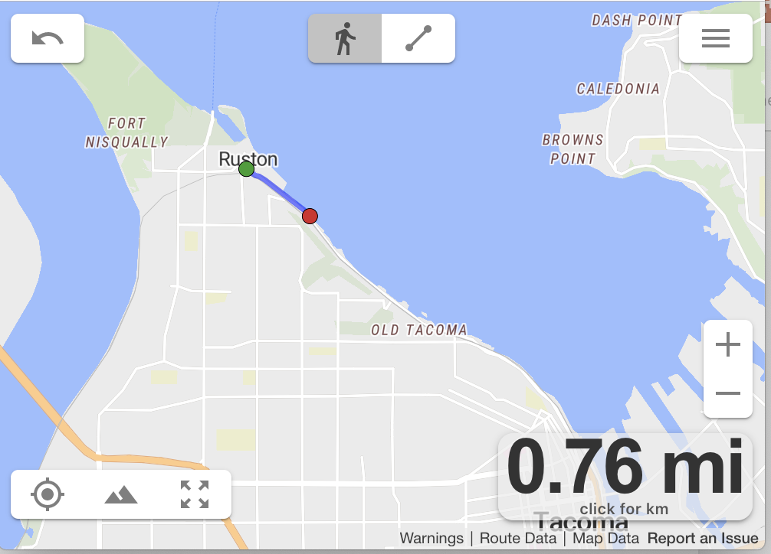
Part 3: Estimating the Cost of Building a Seawall
The final part of the analysis is to consider how much it would cost to prevent these damages. One option to consider is building a sea wall along the shoreline that would prevent the water from reaching the homes given a flooding event.
1. Consider the highest priority shoreline in your region to be protected and estimate the length of the seawall using the website: onthegomap
2. Click on the target in the lower left corner. Then click on the map at the starting point of the wall. To estimate the distance, continue clicking new points along the seawall path using the nearest road or path to the shoreline. To undo a point, click the reverse arrow in the upper left corner.
3. Determine how many feet long the wall would need to be using the conversion, 1 mile = 5280 feet.
In a report on cost estimates of coastal protection, researchers estimated that the cost of building a sea wall is $762 per square foot (Hudson et al. 2015). Assume that the additional cost of building the sea wall 1 foot taller is constant at $762 per square foot for every foot taller the wall is built, i.e. marginal costs are constant.
Pause for Analysis: How much would it cost to build a 1 foot tall sea wall along the length of the shoreline you just measured? After you’ve built the seawall 1 foot tall, how much would it cost to build it another foot taller?
Notes:
Mapping website: https://onthegomap.com/#/create

Slide 11
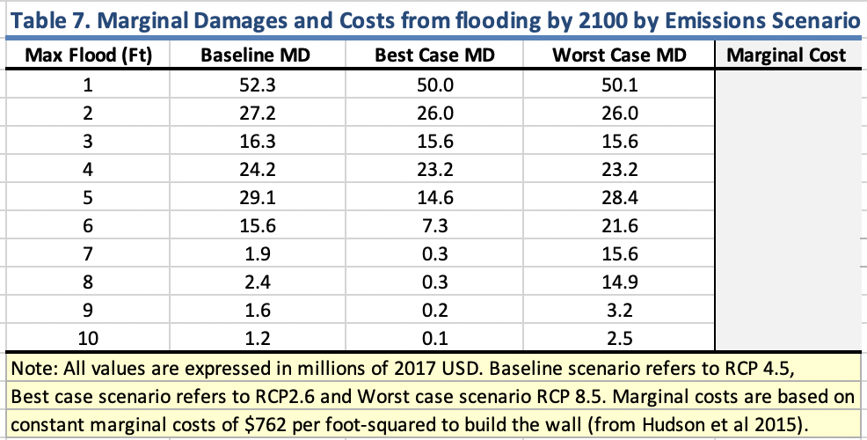
Part 3: Estimating the Cost of Building a Seawall
Now that you have estimates for the cost of building the seawall, the final step is to compare the marginal cost of the sea wall compared to the avoided damages it would prevent to answer two questions:
Is building a sea wall cost effective, that is, would the benefit of building the seawall (measured in avoided housing damages) be greater than the cost?
If it is in the best interest of the region to build a seawall, how tall should it be?
1. To answer these questions, use the cost estimates you calculated on the previous page to fill in the “Marginal Cost” column in Table 7 for the marginal cost of the seawall at each flood height.
2. Notice that the graph in Figure 3 now displays the marginal cost curve for the sea wall.
Pause for Analysis: As a city planner, what recommendations would you make based on your analysis of the graph in Figure 3, i.e. how tall should the wall be? How do the total costs and benefits compare to the marginal costs and benefits of the seawall? Discuss with a partner or in a small group.

Slide 12
Discussion Questions
With a partner or in a small group, discuss the following questions:
Figure 3 highlights all the work you have done thus far in this analysis. With this in mind, what are some of the main assumptions you have made that are underlying the graph, specifically in the calculations for the marginal cost and expected marginal damage curves?
If you were to change these assumptions, how do you think the results would change? How might this change your recommendation on the seawall?
Given the assumptions and limitations you have discussed, how would you go about improving this analysis to make it more realistic?
The extreme sea level rise scenario has a very low probability of occurring. In fact one model reports that even in the event of the worst case scenario (RCP8.5) the likelihood of 2.5+ meters of sea level rise by the end of the century is only 0.1% (Kopp et al. 2014; NOAA, 2017). Given this small probability, why do you think it is still important to take these extreme scenarios into consideration?

Slide 13
Post-Module Memo Assignment
Sea Level Rise Memo Assignment
Suppose that you were hired by the City to conduct an analysis on the impacts and potential damages of impending sea level rise in the region. For this assignment you will need to synthesize the information and data you have analyzed while working through the module into a 2- 3 page memo (including key figures) to the director of the City’s Office of Environmental Policy and Sustainability.
The memo should:
briefly outline the problem,
describe how you conducted the analysis,
summarize your results, including a recommendation for action, and
discuss the limitations of your results.
Keep the writing clear and concise. Your recommendations should be based on data and evidence supported by your analysis.
For guidance on writing a memo, you can refer to this website from Purdue University’s Online Writing Lab.
Notes:
Purdue University online writing lab: Memos website” https://owl.purdue.edu/owl/subject_specific_writing/professional_technical_writing/memos/index.html

Slide 14
References
Hauer, M. E., J. M. Evans, and D R. Mishra. (2016). Millions projected to be at risk from sea-level rise in the continental United States. Nature Climate Change.
Hudson, T., Keating, K., and Pettit, A. (2015). Cost estimation for coastal protection – summary of evidence. Environmental Agency. Report –SC080039/R7
IPCC (2013): Summary for Policymakers. In: Climate Change 2013: The Physical Science Basis. Contribution of Working Group I to the Fifth Assessment Report of the Intergovernmental Panel on Climate Change [Stocker, T.F., D. Qin, G.-K. Plattner, M. Tignor, S.K. Allen, J. Boschung, A. Nauels, Y. Xia, V. Bex and P.M. Midgley (eds.)]. Cambridge University Press, Cambridge, United Kingdom and New York, NY, USA.
Kopp, R. E., R.M. Horton, C.M. Little, J.X. Mitrovica, M. Oppenheimer, D.J. Rasmussen, B. Strauss, C. Tebaldi. (2014). Probabilistic 21st and 22nd century sea-level projections at a global network of tide-gauge sites. Earth's Future, 2(8), 383-406.
Murphy, J. October 14, 2015. The Nation. Retrieved from: https://www.thenation.com/article/3-years-after-hurricane-sandy-is-new-york-prepared-for-the-next-great-storm/
NOAA 2017: Sweet, W. V., Kopp, R. E., Weaver, C. P., Obeysekara, J., Horton, R. M., Thieler, E. R., and Zervas, C. (2017). Global and Regional Sea Level Rise Scenarios for the United States. NOAA Technical Report NOS CO-OPS 083
Sweet, W. V., Kopp, R. E., Weaver, C. P., Obeysekera, J., Horton, R. M., Thieler, E. R., & Zervas, C. (2017). Global and regional sea level rise scenarios for the United States. NOAA.
Memos: General Introduction (n.d.) Purdue Online Writing Lab. Retrieved from: https://owl.purdue.edu/owl/subject_specific_writing/professional_technical_writing/memos/index.html

Slide 15
Module by Lea Fortmann of University of Puget Sound; modified for High School by Dr. Penny Rowe of NorthWest Research Associates (penny@nwra.com), with funding from NSF award #1712282, Division of Undergraduate Education and Office of Polar Programs

Slide 16
Videos
Greenland melt: https://sealevel.nasa.gov/resources/91/greenlands-thinning-ice
West Antarctic Ice Sheet Loss: https://en.wikipedia.org/wiki/West_Antarctic_Ice_Sheet
Larsen C disintegration

Slide 17
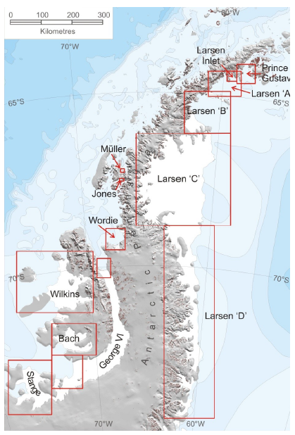
Introduction: Antarctic Ice Melt
Polar Ice is melting
Image to left by A. J. Cook and D. G. Vaughan (creative commons; https://commons.wikimedia.org/wiki/File:Antarctic-Peninsula-Ice-Shelves.png)
Prediction:
First, more snowfall, so gain in total ice mass.
Then, “rapidly warming summer air temperatures trigger extensive surface meltwater production and hydrofracturing of ice shelves by the middle of the century. The Larsen C is one of the first shelves to be lost, about 2055.”
Image Credit: NASA Earth Observatory image by Jesse Allen, using Landsat data from the U.S. Geological Survey
- DeConto and Pollard 2016, Nature

Slide 18
Learning Objectives and Module Overview
Module Outline:
Introduction: Polar Ice Melt
Part 1: Calculating Marginal Damages from Flooding and Sea Level Rise
Part 2: Graphing Marginal Damage Curves in Excel
Part 3: Making Decisions Given Uncertainty
Discussion Questions

